Slide 1

Jumpstart School Improvement with 90 Day Plans
Dr. Brent Anderson
AVID Center
Livelearnandlead.com

Slide 2

Table Tent
School or District & State
Current Role
BRENT
he/him
AVID Center
Plainfield, IL
Program Manager
One thing you hope to take away from today
Show/Movie/Book or Song that you can watch/read/listen to on repeat
Refine the use of 90 day plans
Footloose

Slide 3

Who’s in the Room?
Dr. Brent Anderson
AVID Center – Program Manager
Live. Learn. Lead Consulting and Training
Aurora University Adjunct Faculty
25 years Principal and Teacher

Slide 4

Introductions
If the doors had slid closed for your educator profession, what might the next set of doors have had in store for your professional journey?

Slide 5
Group Norms
BE OKAY WITH NON-CLOSURE
Notes:
Accept non-closure – we have 70 minutes together. We want to provide information and opportunity to apply to your own work. That said, we likely won’t have enough time to develop a full plan.

Slide 6

Performance Objectives
Deconstruct a current problem of practice using a 90-day plan model to identify the goal, strategy, and tactics that will provide a specific focus and guide movement toward achieving the goal
Identify potential leading indicators to measure improvement toward your goal

Slide 7



Agenda
The Problem with School Improvement Plans
Why 90 Days?
Goal – Strategy - Tactics
Scorecard/Evaluation
Maintaining Focus

Slide 8

Essential Question
Focused Notes | TOPIC/OBJECTIVE: | NAME:
 |  | CLASS/PERIOD:
 |  | DATE:
ESSENTIAL QUESTION: How can I leverage a 90-day plan model to address
a current problem of practice and subsequently improve student
outcomes?

Slide 9
Quote Analysis
Step 1: Read the quote
"One of the biggest threats to most yearly SIP plans is "life." And that's the first problem with annual planning. Even the mundane day-to-day challenges we face can threaten to derail our tidy, predictable plans." – Dr. Robyn Jackson
Step 2: Choose sole mate
Introduce yourself and use the sentence frame below to discuss the quote.
I think/feel/believe that in her quote about _____, Jackson is saying that _____.
Think about our EQ: How can I leverage a 90-day plan model to address a current problem of practice and subsequently improve student outcomes?

Slide 10
Quote Analysis
Step 3: Craft a Six-Word Story
The Six-Word Story helps distill the essence of an idea.
Word Bank
opportunity reflect improve plan transform
Step 4: Be Prepared to Share

Slide 11

The Problem with SIP
  According to Dr. Robyn Jackson
  Are easily derailed by “life”
  There’s no urgency
  Discount continuous learning
Square your pair, discuss your level of agreement with Dr. Jackson’s assertions.

Slide 12
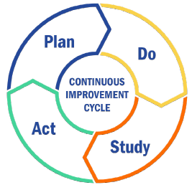
Why 90 Days?
According to Dr. Robyn Jackson
  Allow agility and responsiveness to outside challenges
  Create space to infuse new learning
  Create opportunity to celebrate success
  Narrow the focus to avoid initiative overload

Slide 13

What could it look like, sound like, feel like, to develop a 90-day plan?

Slide 14

Identifying the Right Problem
The Problem
5 Whys
The Root Cause
There are lots of open seats in our Dual Credit and AP sections. The students who enroll generally do well
Look for the most likely systemic cause of the problem
Look for the most likely systemic cause of the problem
Notes:
April: Often we notice things, have wonderings that may indicate a problem. But is it the right problem to focus on? Our students are not reading at grade level so let’s focus on moving students on the cusp of meeting standards.
The room is the team. Collect answers on chart paper?

Slide 15

What’s Your Problem???
Quickwrite
As you think about your campus or district, what is one challenge that you would like to begin to address?
Use this time to develop your problem statement.
Microsoft Stock Image
Notes:
April: 3 minutes to consider a pressing problem of practice and develop a problem statement. Thinking also about your SIP plan that you haven’t made movement on?---Lets get a sense of who is in the room to support how we tackle the 5 whys

Slide 16

Root Cause Analysis - 5 Whys
Take your problem statement
Engage in the 5 Whys Protocol with others near you.
Take good notes
Identify the root cause
Microsoft Stock Image
Notes:
Huddle based on site levels groups of 4 or 5 ish

Slide 17

Effective Plans
Goal
Student-focused learning/skill outcome
What are the existing constraints that are making achieving the goal difficult?
Strategy
Action that will remove the biggest constraint.
Multiple strategies will likely be used to address the constraints
Focus on 1 at a time.
Tactic
Specific action steps
Data should inform changes in tactics over time.
Jumpstart School Improvement with 90 Day Plans

Slide 18
Chicago Marathon
Goal
(Outcome)
January 4, 2022, I wrote a goal stating that I wanted to complete the Chicago Marathon in 2022 (October 2022)
I had run 13.1 miles once.
Strategy
(Action to remove biggest obstacle)
Run consistently (3 days a week) from January through late September to build capacity to run at least 20 miles.
Success measure: Be able to run 20 miles by September 25, 2022
Tactic
(Action steps)
Cross train
Build endurance through long slow runs
Explore hydration and nutrition
Run ½ marathon in July (success measure)
Increase mileage (weekly) distance (session) over time (success measure)
Jumpstart School Improvement with 90 Day Plans

Slide 19

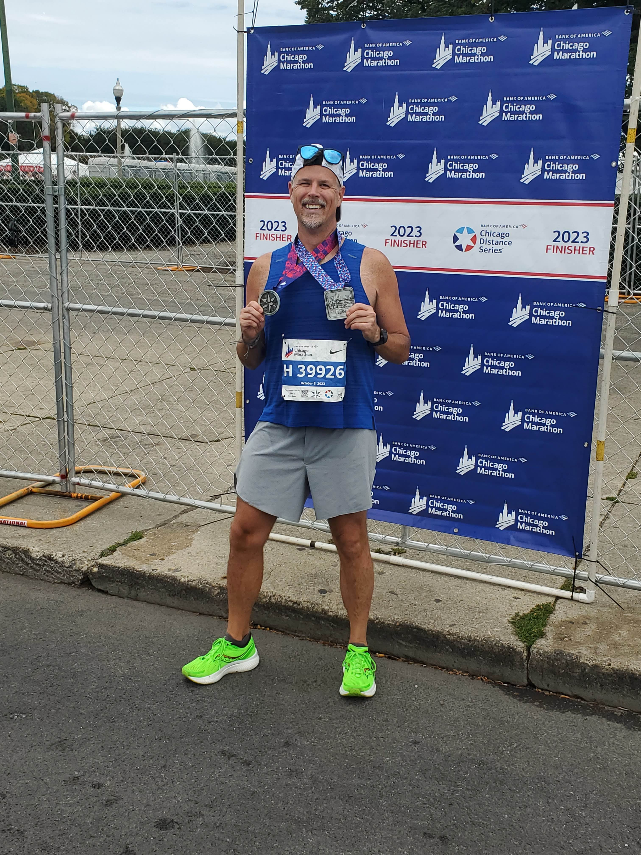
Results
2022 – Success
2023 – Wanted to run sub 4:00 hours
Jumpstart School Improvement with 90 Day Plans

Slide 20


Open Seats in Rigorous Courses
Goal
Increase the percentage of students taking and being successful (C or better) in a course of rigor (Dual Credit or AP) to 70% of all enrolled students by the end of the 24-25 academic year.
Strategy
Tactic
Jumpstart School Improvement with 90 Day Plans

Slide 21

What’s the Goal???
Based on your root cause analysis:
Draft a potential student-focused goal
Microsoft Stock Image
Jumpstart School Improvement with 90 Day Plans

Slide 22
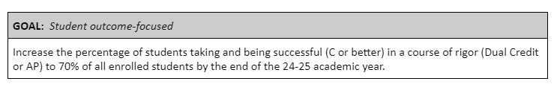
What specific action, taken over the next 90 days, will aid in removing the current, largest constraint to achieving the goal?
Questions to consider:
Vision – What would it look like if we achieved this goal?
Challenges – What is preventing us from achieving the goal?
Opportunities – What strengths do we have that could help us achieve the goal?
What actions might we take that bring us closer to achieving our vision or goal?
Jumpstart School Improvement with 90 Day Plans

Slide 23
Open Seats in Rigorous Courses
Goal
Increase the percentage of students taking and being successful (C or better) in a course of rigor (Dual Credit or AP) to 70% of all enrolled students by the end of the 24-25 academic year.
Strategy
Develop staff buy-in around rigorous Tier 1 instruction
Tactic
Jumpstart School Improvement with 90 Day Plans

Slide 24

What actions might we take that bring us closer to achieving our vision or goal?
Talk to those near you
Add to your notes
Jumpstart School Improvement with 90 Day Plans

Slide 25

Data Rich-Information Poor
4th quarter
Game Clock: 2:03
Home Team: 13 Away Team: 20
3rd down, 2 yards to go
Ball on the Away Team’s 8-yard line
Microsoft Stock Image
Jumpstart School Improvement with 90 Day Plans
Notes:
As we think about goals and strategies we need to be thinking about evaluation.

Slide 26
Lead and Lag Indicators
Lead Indicators
Lag Indicators
“Performance measures that provide early signs for determining if an organization is on track for achieving a goal.” (Kowal & Ableidinger, 2011)
“Leading indicators are data that can lead to a result, data over which one has some control” (Jackson, 2022)
Data after the fact that is too late to change
Results themselves
Jumpstart School Improvement with 90 Day Plans

Slide 27
In 90 days are we going to see a marked change in data surrounding this goal?
What could we be monitoring to better inform the work moving forward?
As we consider the strategy how will we know if we are making progress?
Jumpstart School Improvement with 90 Day Plans

Slide 28

Open Seats in Rigorous Courses
Goal
Increase the percentage of students taking and being successful (C or better) in a course of rigor (Dual Credit or AP) to 70% of all enrolled students by the end of the 24-25 academic year.
Strategy
Develop staff buy-in around rigorous Tier 1 instruction
Tactic
Develop a common definition of “rigor”
Assess the current state of instruction against that definition
Share results and develop a leadership team
Jumpstart School Improvement with 90 Day Plans

Slide 29
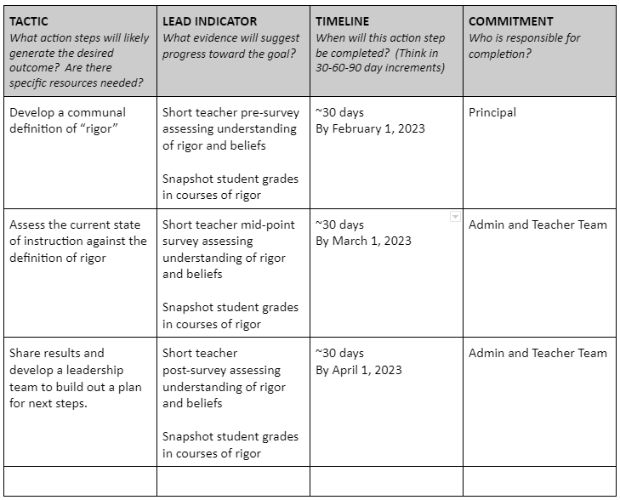
Tactics - Action Plan
What initial thoughts do you have about potential lead indicators and action steps?
Jumpstart School Improvement with 90 Day Plans

Slide 30

Maintaining Focus
How can you create a regular rhythm to this work?
  Daily
  Weekly
  Monthly
Microsoft Stock Image
Jumpstart School Improvement with 90 Day Plans

Slide 31

Your Next Steps
Based on what we did today, what are your next steps?
Send an email
Calendar some time
Share your contact info with someone near you as an accountability partner
Voice memo
Microsoft Stock Image
Jumpstart School Improvement with 90 Day Plans

Slide 32

Thank You
Dr. Brent Anderson
brent.j.anderson1@gmail.com
http://www.livelearnandlead.com

Slide 33

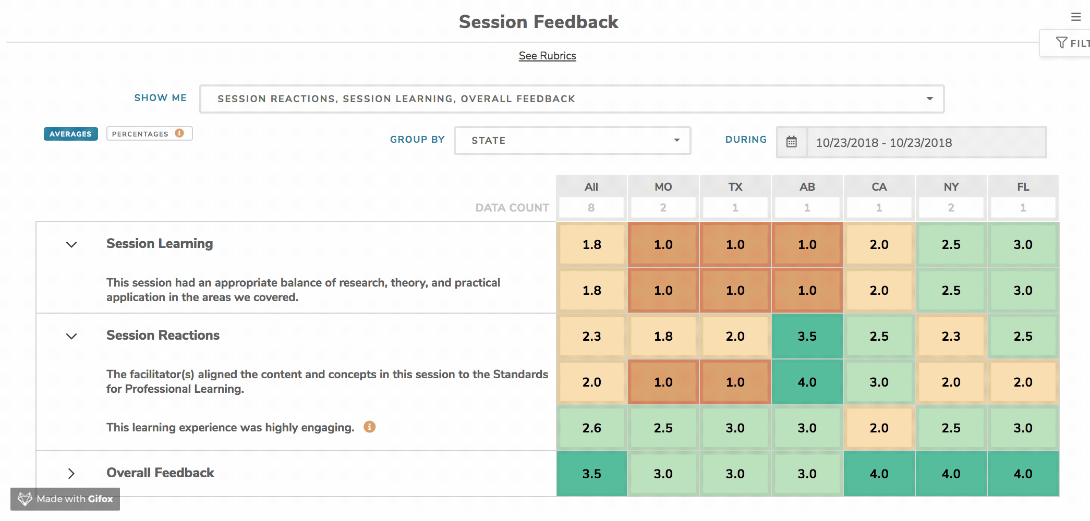



Session Evaluation
Take our 3 minute survey!
kickup.co/2023LF
Session ID: 3225
NOTE: Session ID should be in all CAPS
and is case-sensitive.
Your responses power our report

